Slide 1
Navigability of Real-World Networks
Kunal Sanghvi - 011809708
Arnav Jain - 011809037

Slide 2
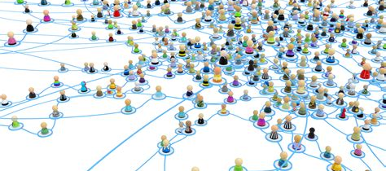
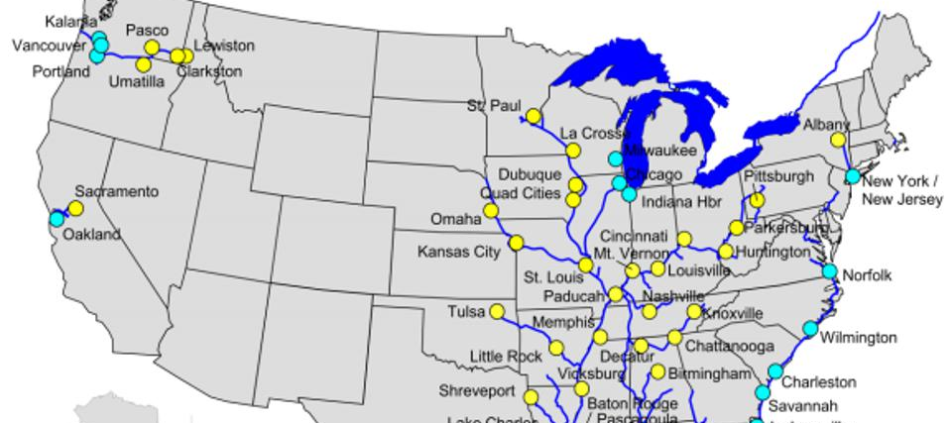
Navigability
Navigability refers to the ease with which one can travel through a network, such as a physical or virtual network. It is affected by factors such as :
topology
connectivity
accessibility
the presence of obstacles
the presence of barriers

Slide 3
Social Network
A social network is a digital platform that enables people to connect and interact with others who share similar interests, backgrounds, or experiences. It allows users to share information, exchange ideas, and build relationships with others in their network.
The three properties of a social network are:
Nodes or actors: Individuals or entities within the network who are connected to other nodes.
Edges or ties: The relationships or connections between nodes that define the structure of the network.
Social capital: The resources, such as information, influence, and support, that are available to individuals or groups within the network through their social connections.

Slide 4
Transportation Network
A transportation network is a system of interconnected transportation infrastructure, such as roads, railways, waterways, and airports, that allows people and goods to move between different locations. It provides a means of transportation for individuals and facilitates the movement of goods and services, supporting economic activities and social interactions.
The three properties of a transportation network are:
Nodes or locations: The points in the network where transportation activities take place, such as terminals, stations, or ports.
Links or edges: The physical infrastructure that connects the nodes, such as roads, railways, waterways, or air routes.
Flow or traffic: The movement of people, goods, or vehicles through the network, which can be affected by factors such as congestion, capacity, or demand.

Slide 5
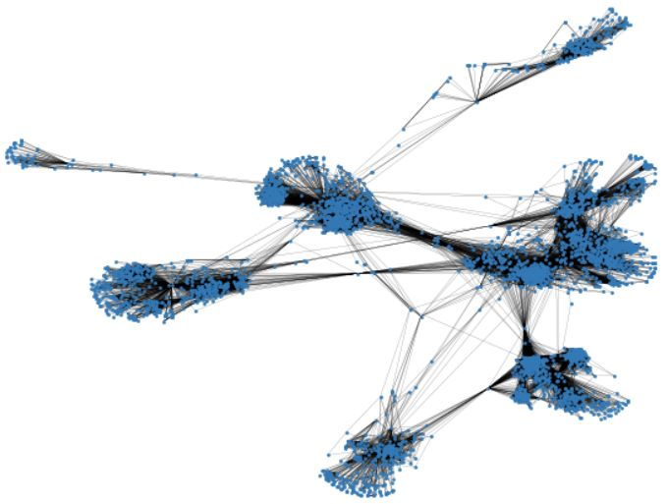
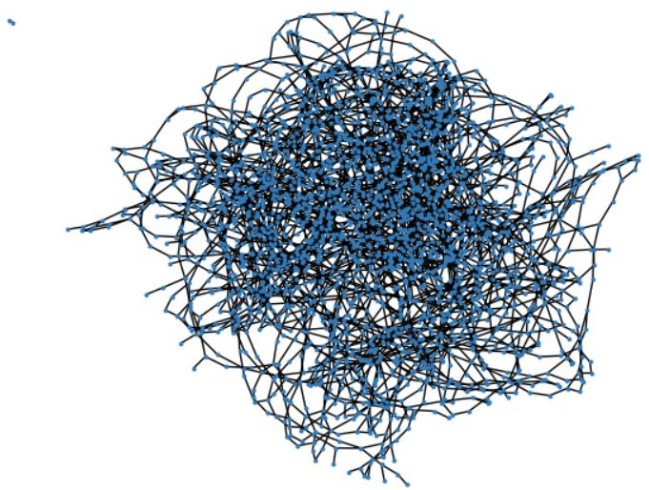
Dataset
Social Network
Transportation Network
Facebook Network - https://snap.stanford.edu/data/ego-Facebook.html [1]
Minnesota Road Network - https://networkrepository.com/road.php [2]

Slide 6
Properties of Dataset
Social Network
Transportation Network
Nodes – 4039
Edges – 88234
Number of triangles – 1612010
Diameter – 8
Clustering coefficient – 0.6055
Global clustering coefficient – 0.5191
Modularity - 0.7773
Nodes – 2640
Edges – 3302
Number of triangles – 53
Diameter – 99
Clustering coefficient – 0.0159
Global clustering coefficient – 0.0279
Degree distribution - [0, 96, 1436, 797, 310, 1]

Slide 7
Analysis of Dataset based on the following parameters:
Centrality Measures
Community Detection
Shortest Path Algorithm
Route Planning
Congestion
Landmark

Slide 8
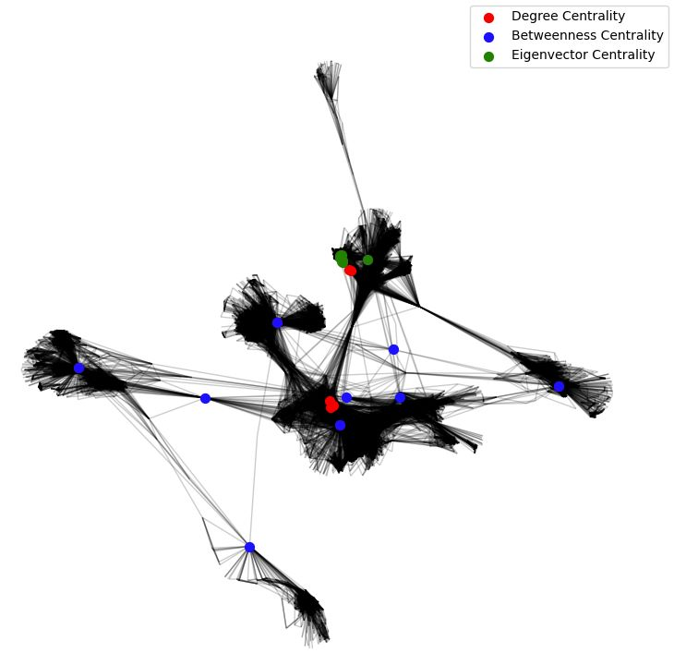
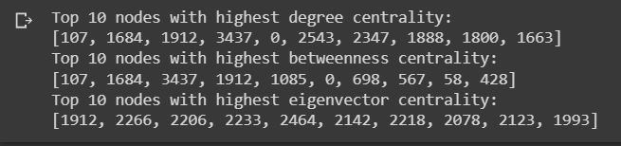
Centrality Measures
Facebook Network

Slide 9
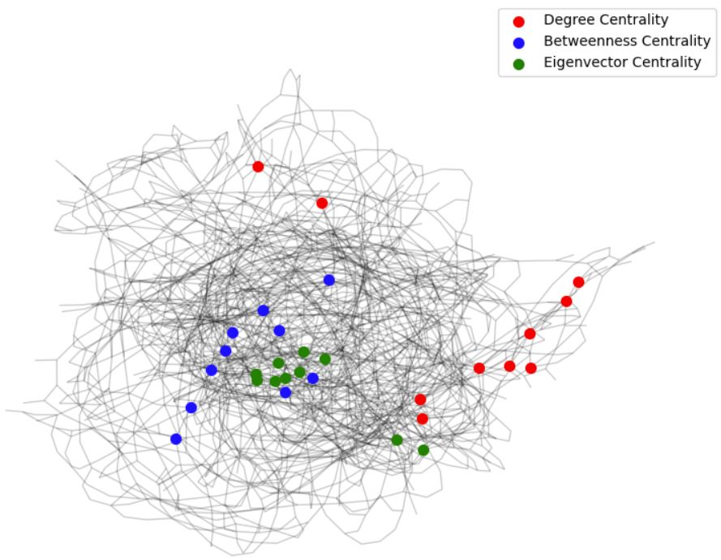
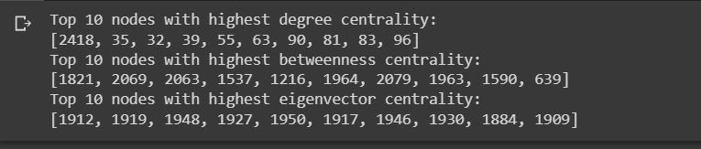
Centrality Measures
Transport Network

Slide 10
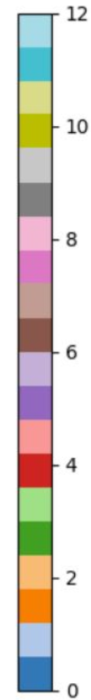
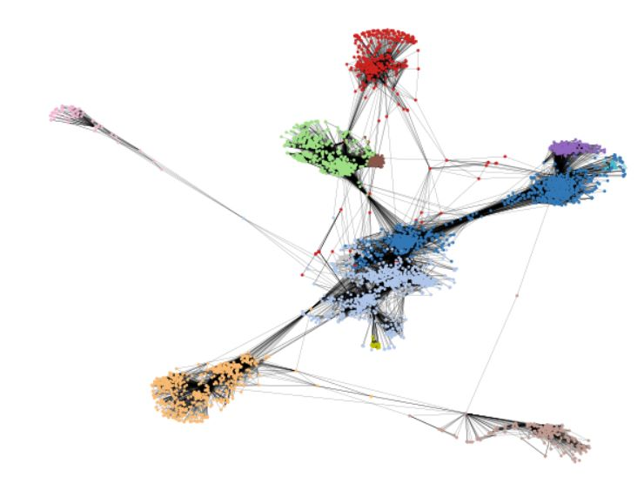
Community Detection
Facebook Network
Facebook Network

Slide 11

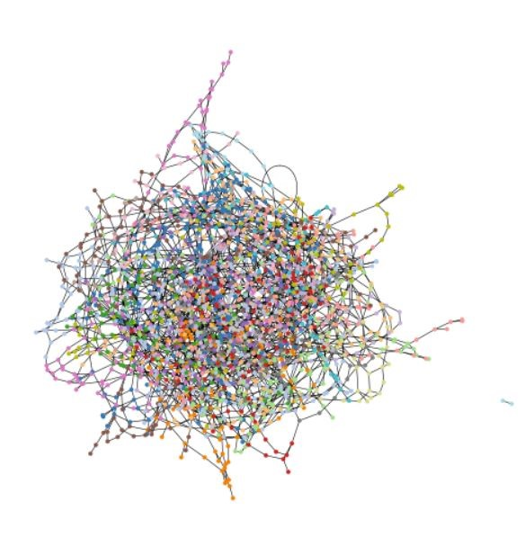
Community Detection
Transport Network
Transport Network

Slide 12
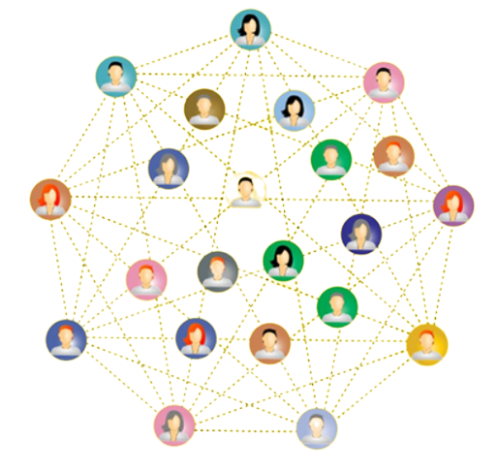
Shortest Path Algorithm
The average shortest path calculated for the social network [3]:
Random Walk – 3.6024
Dijkstra – 3.8269
Floyd Warshall – 3.6925
Page Rank – 1.8462
https://www.analyticsvidhya.com/blog/2020/04/community-detection-graphs-networks/

Slide 13
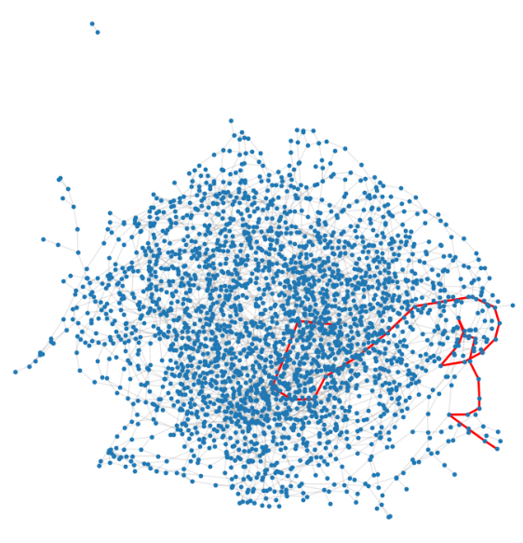
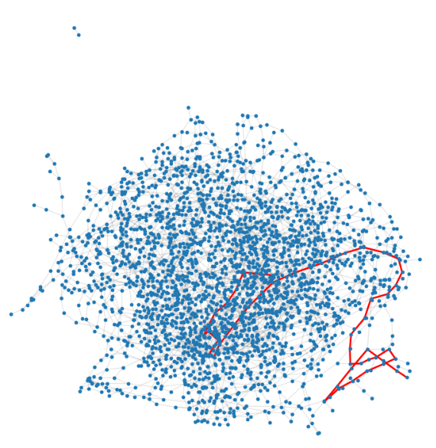
Route Planning - Congestion
Transport Network Pre - Congestion
Transport Network Post - Congestion

Slide 14
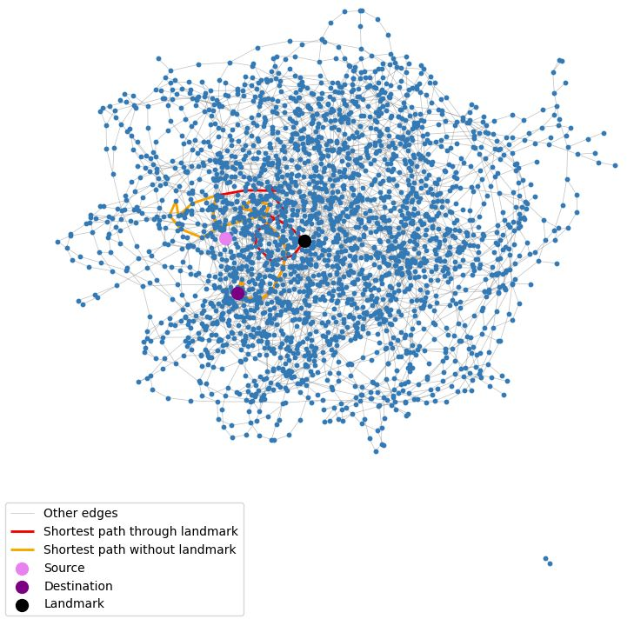
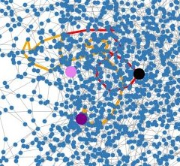

Route Planning - Landmark

Slide 15
Remaining Work
To calculate the shortest path algorithm for the social network using A*.
To calculate the shortest path algorithm for transportation networks using different methods.

Slide 16
Future Scope
More comprehensive dataset can be taken with weighted edges to study more about the navigability in the networks.
The transportation networks are too complex hence an algorithm can be developed which has low time complexity to get the shortest path between any two nodes.
Directed graphs can be taken into consideration to provide more information about navigability.
This study can be extended to biological networks

Slide 17
References
Tools
Language
Library
Python
NetworkX
Matplotlib
Random
Google Colab
Facebook. (2022). Facebook Combined Snap Dataset. Retrieved from https://research.fb.com/downloads/facebook-combined-snap-dataset/
Ryan A. Rossi and Nesreen K. Ahmed. (2015). The Network Data Repository with Interactive Graph Analytics and Visualization. In Proceedings of the Twenty-Ninth AAAI Conference on Artificial Intelligence, 4292-4293. Retrieved from http://networkrepository.com/road-minnesota.php
Easley, D., & Kleinberg, J. (2010). The Small World Phenomenon. In Networks, Crowds, and Markets: Reasoning About a Highly Connected World (pp. 501-522). Cambridge University Press.

Slide 18
THANK YOU

